Slide 1
Asylum in the U.S.: An Urgent Briefing on the Latest Policy Changes
July 8, 2020

Slide 2
Speakers
Smita Dazzo
Director of Legal Services
Naomi Steinberg
Vice President of Policy and Advocacy
Rebecca Kirzner
Senior Director of Grassroots Campaigns

Slide 3
Asylum: Protecting Persecuted Persons
U.S. Asylum Law- codified in the 1980 Refugee Act, based on definition of refugee in the UN Refugee Convention. The US is a signatory to the 1967 Optional Protocol Relating to the Status of Refugees
In order to be eligible for asylum, the applicant has to meet the definition for “refugee,” as defined by the Immigration & Nationality Act (INA)
A refugee is:
Any person who is outside any country of such person’s nationality or, in the case of a person having no nationality, is outside any country in which such person habitually resided,
and who is unable or unwilling to avail himself or herself of the protection of that country
because of persecution or a well-founded fear of persecution
on account of race, religion, nationality, membership in a particular social group, or political opinion.”
The asylum process is the counterpart of the refugee process for those who seek refugee status but are already on U.S. soil.

Slide 4
Asylum: Current Protected Grounds
Race- Rohingya people of Burma, Blacks in South Africa during apartheid
Religion- Atheists in Iran, Christian converts in Syria, Chinese Muslim Uyghurs
Nationality- Ethnic minorities in Libya, Hutus vs. Tutsis (often conflated with ethnic group/identity)
Political Opinion- supporters of the opposition political party, the family of an activist, even if they have no political leaning, feminists, people opposed to gang violence
Membership in a particular social group- LGBTQI, survivors of GBV, members of a particular family group, former gang members, human rights workers, journalists

Slide 5
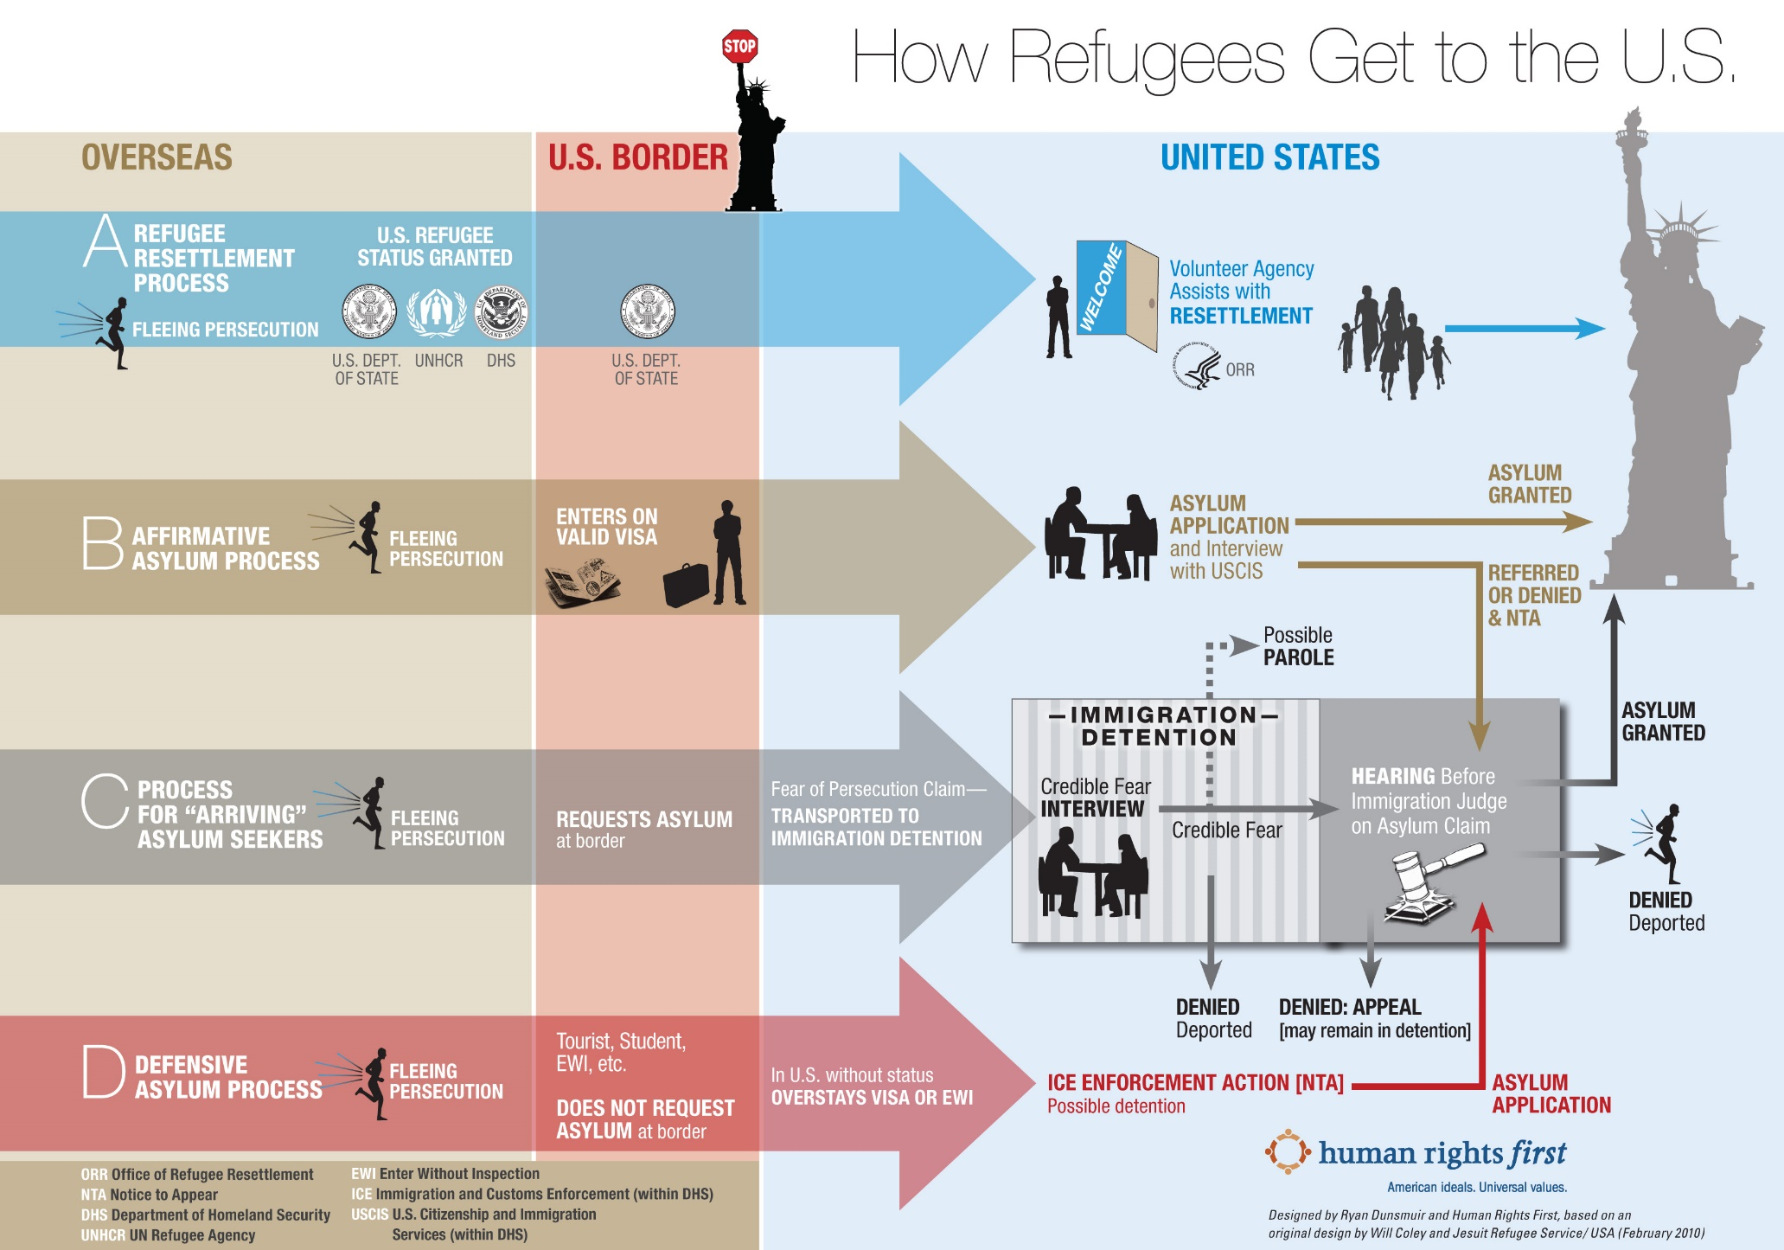

Slide 6
Recent Changes to the U.S. Asylum System
Then-Attorney General Sessions severely limits the availability of asylum for survivors of domestic violence and gang violence (Matter of A-B-)
Metering
Banning of individuals who do not present at a port of entry from applying for asylum. Currently enjoined.
Third Country Transit Ban

Slide 7
Recent Changes to the U.S. Asylum System
Migration Protection Protocols (MPP or Remain in Mexico)
Asylum Cooperative Agreements (ACA) with Guatemala, Honduras and El Salvador
Prompt Asylum Claim Review (PACR), applying to individuals other than Mexico, and the Humanitarian Asylum Review Process (HARP), applying to Mexican nationals.

Slide 8
U.S. Asylum System: COVID-19 Update
On March 20th, the CDC issued an Order that authorizes the Customs and Border Protection (CBP) to expel people who seek to enter the United States without documentation at the Canadian or Mexican borders, based on the argument that they could be “vectors” for COVID-19.
The Order was originally meant to be in effect for 30 days, but on April 20th, the CDC extended it for an additional 30 days, and on May 20th, extended it indefinitely.
The Order grants the Trump administration the authority to refuse access to U.S. territory and our asylum system to people seeking protection.

Slide 9
U.S. Asylum System: COVID-19 Update
By summarily turning back asylum seekers without any due process, the administration is in violation of core U.S. refugee and immigration laws.
Since the advent of COVID-19, CBP has already expelled at least 41,000 migrants, including asylum seekers and unaccompanied children.
The U.S. is obligated to comply with the principle of non-refoulement-an asylum seeker cannot be sent to another territory or state where they fear threats to their life or freedom on protected grounds.

Slide 10
Proposed Asylum Regulations
On June 15, the Departments of Justice and Homeland Security jointly released a series of proposed changes to the asylum system that, if implemented, would essentially make it impossible for almost anyone to find safety in the United States.
161 pages of sweeping proposed changes that would entirely eviscerate the U.S. asylum system.
Completely barring granting of asylum on the basis of gender
Changing the very definition of “persecution”
Redefining some of the core grounds for asylum claims, including membership in a “particular social group,” which could have a dire impact on women and LGBTQ individuals.
Denying asylum to people who transited through other countries on their way to the United States
Denying asylum seekers basic due process and their day in court by allowing immigration judges to decide cases just based on asylum seekers’ written applications

Slide 11
Proposed Asylum Regulations
30-day period during which the public can provide comments
The Rule essentially takes many of the most egregious changes to the U.S. asylum system from the last three years, adds upon them, and when taken together, would effectively eliminate asylum eligibility for almost everyone who seeks it.

Slide 12
Proposed Changes & Impact
CURRENT LAW
Every asylum applicant who passes a CFI has the right to testify (and call witnesses) before a judge about their persecution.
Persecution is defined as “a threat to the life or freedom of, or the infliction of suffering or harm upon, those who differ in a way regarded as offensive.”
NEW RULE
A judge can essentially deny asylum, without a hearing, if they think that the application, on its face, does not present a “good” asylum claim
Very narrow definition- The rule emphasizes that the harm must be “extreme” and that threats must be “exigent.” No guidance on adjudicating claims by children. It also does not require adjudicators to consider cumulative harm.
IMPACT
Asylum applicants that don’t speak English, are illiterate and filing pro se may not get the chance to defend their case
Applicants who have suffered multiple “minor” beatings, death threats, or multiple short detentions would likely be disqualified under the proposed rule

Slide 13
Proposed Changes & Impact
CURRENT LAW
PSGs are defined and should be assessed on a case-by-case basis in conjunction with all supporting evidence and information
You can update your asylum application any time before your hearing. Can also redefine PSG on appeal or in a Motion to Reopen
NEW RULE
Many new bases which would make PSG insufficient- such as high rate of crime in a country or being the victim of a private criminal act of which gov’t authorities were unaware or uninvolved
One chance to define their particularized social group- can’t do it on appeal, or with an attorney, or even if you have a claim for ineffective assistance of counsel
IMPACT
Victims of gang violence, or private actors – especially in dangerous countries like Northern Triangle would essentially be ineligible for asylum
An asylum seeker’s life would essentially depend on their ability to expertly craft arguments in the English language in a way that satisfies highly technical legal requirements. Also no form of relief for people with bad attorneys

Slide 14
Proposed Changes & Impact
CURRENT LAW
Applicants fleeing gender based violence could succeed in asylum based on PSG, political opinion, or even potentially religion
Asylum applicants must show that their persecution is on account of (“nexus”) a protected ground- all assessed on a case-by-case basis
NEW RULE
Gender based claims will no longer be considered valid (changes to definition of political opinion, changes to nexus)
Would allow for blanket denials based on a number of circumstances will generally be insufficient to demonstrate persecution (including where there is interpersonal animus or retribution or where there is “criminal activity”)
IMPACT
Women who cannot escape their abusive relationships and are not protected by their governments have no recourse
Almost all asylum claims deal with some kind of retribution, or punishment, and all harm that rises to the level of persecution could be characterized as “criminal activity,” since in virtually every country beatings, rape, and threatened murder is criminalized activity. This blanket rule essentially eliminates the ability to grant asylum based on private actor harm.

Slide 15
Proposed Changes & Impact
CURRENT LAW
Asylum is a discretionary benefit. Discretion should be based on the totality of circumstances and past persecution or a strong likelihood of well-founded persecution should generally outweigh all but the most egregious adverse factors.
NEW RULE
Expands Bases for Discretionary Denials: Identifies as “significantly adverse” factors to consider in denying an application for asylum even if the applicant is otherwise eligible:
(1) unlawful entry to the U.S.;
(2) failure to seek asylum in a country through which the asylum seeker transited prior to arriving in the US;
(3) use of false or fraudulent documents to enter the U.S.;
(4) being unlawfully present in the U.S. for more than a year prior to filing for asylum;
(5) for individuals present in the U.S., failing to file taxes.
IMPACT
Almost every single asylum seeker that arrives to the US through the southern border would be ineligible. Anyone stuck in the metering system or who took more than 14 days to cross Mexico, people that can’t get passports (in some countries women can’t get it without husband’s permission), people who are denied visas, those who are uninformed about immigration or tax laws, persons with severe PTSD, those with changed circumstances

Slide 16
Changes to Employment Authorization eligibility and procedure
Applicants must wait 365 days instead of 150 to apply for EAD
Prevents asylum applicants who did not file their application within their first year of arrival to the United States
Prevents asylum applicants who entered the United States without inspection
Creates additional criminal bars to eligibility
Provides for automatic termination of eligibility for denied cases
No longer allows for parolee eligibility

Slide 17
Submitting a Comment!
All comments must be submitted by 11:59 ET on July 15th.
HIAS asks that everyone who wants to protect our asylum system speak out. Make a public comment! Before the proposed changes can be finalized, the administration must review each and every unique comment that they receive; your comments are important!

Slide 18
Submitting a Comment!
Don’t let the scope of the proposed regulations scare you!
Your comment does not need to cover everything that the regulations cover.
Use the HIAS template at www.hias.org/take-action-new-proposed-asylum-regulations.
It also includes the link that you must use to submit your comment.
Questions between now and July 15th? Let us know!

Slide 19
To ask questions:
Write a message in the Q&A box at the bottom of the screen.
Or
Email your question to takeaction@hias.org

Slide 20
Thank You!
To submit a comment on the regulations:
www.hias.org/take-action-new-proposed-asylum-regulations
For other ways to take action, visit hias.org/take-action

